Slide 1

The Comparison of Local and Global Early Fake News Detection Methods
Maciej Pawlikowski, Hubert Ruczyński,
Bartosz Siński, Adrian Stańdo
Notes:
Good morning, during today’s presentation we want to talk about our project proposal, concerning the task of early fake news detection. In our work, we want to propose a study that evaluates, whether the SOTA detection methods work better in local or global setting.

Slide 2
01
Problem description: Why early detection of Rumors and Fake News is so important?
Notes:
But, why exactly early detection of rumors is so important?

Slide 3
Problem description
Why should we use fake news and rumor detection methods?
To prevent the spread of misinformation and disinformation.
To protect people from harm.
To promote democracy and civic engagement.
What are the possible benefits of detecting fake news and rumors?
Protecting public health.
Preventing violence.
Ensuring fair elections.
Notes:
Well, it is important for a number of reasons:
To prevent the spread of misinformation and disinformation. Fake news can be spread quickly and easily, especially online. Once it has been shared widely, it can be difficult to correct or debunk.
To protect people from harm. Fake news can be used to manipulate people's opinions and behavior. It can also be used to spread harmful stereotypes and prejudices.
To promote democracy and civic engagement. A well-informed citizenry is essential for a healthy democracy.
Here are some specific examples of how early detection of fake news can be beneficial:
Protecting public health. Fake news about vaccines can lead people to make bad decisions about their health. Early detection of this type of fake news can help to protect people from getting sick.
Preventing violence. Early detection of this type of fake news can help to prevent tragedies from happening.
Ensuring fair elections. Fake news about candidates or elections can mislead voters. Early detection of this type of fake news can help to ensure that elections are fair and that the results are accurate.

Slide 4
Project description
Develop a new method to quickly spot trending rumors on social media.
Utilize data extracted from platforms like Twitter, enriched with textual content to detect patterns and focus on key inquiry phrases such as "Is this true?„
Use clustering algorithms to group posts potentially related to the topic.
Develop a classifier to prioritize these clusters based on the likelihood of their association with the disputed fact.
The project aims to deliver a model that is able to efficiently pinpoint social media rumors, helping fact-checkers, journalists, and online platforms.
Notes:
Now with the general knowledge about the importance of fake news detection, let’s take a closer look at the formal description of our project:
Develop a new method to quickly spot trending rumors on social media by focusing on specific skeptical phrases, rather than assessing their authenticity.
Utilize data extracted from platforms like Twitter, enriched with textual content to detect patterns and focus on key inquiry phrases such as "Is this true?" As foundational features.
Use clustering algorithms (e.g., K-means, Hierarchical clustering) to group posts potentially related to the same disputed factual claim.
Develop a classifier to prioritize these clusters based on the likelihood of their association with the disputed fact.
The project aims to deliver a model that is able to efficiently pinpoint social media rumors, helping fact-checkers, journalists, and online platforms.

Slide 5
02
Literature Review
Topic detection, Fake News Detection,
and Explainability for NLP solutions
Notes:
In order to know more about the fake news detection task, we conducted an insightful literature review, that focuses on 3 pillars, required by the project description: topic detection, fake news detection, and explainability for NLP solutions.

Slide 6
Literature Review
Title | Topic | Authors | Description
Topic detection with recursive consensus clustering and semantic enrichment | Topic Detection | Vincenzo De Leo, Michelangelo Puliga, Marco Bardazzi, Filippo Capriotti, Andrea Filetti, Alessandro Chessa | Presents opportunities and challenges considering the topic detection in Twitter debates. It suggests a framework with stable clustering based on Non-Negative Matrix Factorization (NMF), and semantical enrichment of short messages.
Clustering and topic modeling over tweets: A comparison over a health dataset | Topic Detection | Juan Antonio Lossio-Ventura, Juandiego Morzan, Hugo Alatrista-Salas, Tina Hernandez-Boussard, Jiang Bian | Introduces a framework for topic detection in Twitter debates. It shows how to evaluate clusterings with the Calinski-Harabasz index, and the Silhouette Coefficient, and it uses those metrics to compare the efficiency of various LDA approaches to topic modeling.
Improving Fake News Detection Using K-means and Support Vector Machine Approaches | Fake News Detection | Kasra Majbouri Yazdi, Adel Majbouri Yazdi, Saeid Khodayi, Jingyu Hou, Wanlei Zhou, Saeed Saedy | Describes the importance of feature selection in fake news detection. Authors propose a method-based K-means and SVM outperforming state-of-the-art techniques.
Notes:
The first paper presents opportunities and challenges considering the topic detection in Twitter debates. It suggests a framework with stable clustering based on Non-Negative Matrix Factorization (NMF), and semantical enrichment of short messages.
Another work introduces a framework for topic detection in Twitter debates. It shows how to evaluate clusterings Calinski-Harabasz index, and the Silhouette Coefficient, and uses those metrics to compare the efficiency of various LDA approaches to topic modeling.
In case of the fake news detection, we found a paper describing the importance of feature selection in fake news detection. Its authors propose a method-based on simple algorithms K-means and SVM outperforming state-of-the-art techniques.

Slide 7
Literature Review
Title | Topic | Authors | Description
Fake News Detection using Machine Learning with Feature Selection | Fake News Detection | Z. Tian. S. Baskiyar | The paper proposes a fake news detection system using KNN and utilizing Genetic and Evolutionary Features Selection. Additionally, the authors test the viability of the quantum version of KNN (QKNN)
A systematic survey on explainable AI applied to fake news detection | Explainability | Athira A.B., S.D. Madhu Kumar, Anu Mary Chacko | The survey covers fake news detection models that use explainable AI (XAI) approaches to gain more insight and a better understanding of fake news detection. Furthermore, the authors are discussing possible research opportunities in this area.
Towards Machine Learning Explainability in Text Classification for Fake News Detection | Explainability | Lukas Kurasinski, Radu-Casian Mihailescu | In this paper, authors perform fake news detection using two deep learning models: architecture that combines convolutional neural networks and bidirectional recurrent neural networks (BiDir-LSTM-CNN) and bidirectional encoder representation from transformers (BERT). Using attention weights text is color-coded to mark important words for the models.
Notes:
The second paper regarding fake news detection proposes a system using KNN and utilizing Genetic and Evolutionary Features Selection. Additionally, the authors test the viability of the quantum version of KNN called QKNN.
Finally, to understand more about the explainability of fake news detection methods, we’ve read the survey that covers various models that use explainable AI (XAI) approaches to gain more insight and a better understanding of fake news detection.
Another work performs fake news detection using two deep learning models: architecture that combines convolutional neural networks and bidirectional recurrent neural networks (BiDir-LSTM-CNN) and bidirectional encoder representation from transformers (BERT). Using attention weights text is color-coded to mark important words for the models.
Additionally, we also read the papers included in the description of our topic, however quite surprisingly it came out that they are only loosely related to the formal task, and didn’t prove to be useful. Moreover, one of these papers described around 15 datasets concerning the topic detection task, yet only 2 of those sources work currently.

Slide 8
03
Dataset Description:
Fake News Corpus
Notes:
With an apriori knowledge about our task, we started searching for the dataset on our own, in order to find something closely related to described literature. Unfortunately, since Twitter, and Reddit closed their open APIs it is hard to find sources, tracking the internet discussions.

Slide 9
Datasets
News and fake news: data can be collected online Problem: annotation,
Many different open-source datasets, however, each of them has their own shortcomings.
BuzzFeedNews - news published on Facebook; during the US election in 2016; contains only links to Facebook posts containing links.
CREDBANK - 60 million tweets; 96 days in 2015; accessible via the AWS cloud for a small fee; labels are not provided for the tweets - only events were identified.

Slide 10
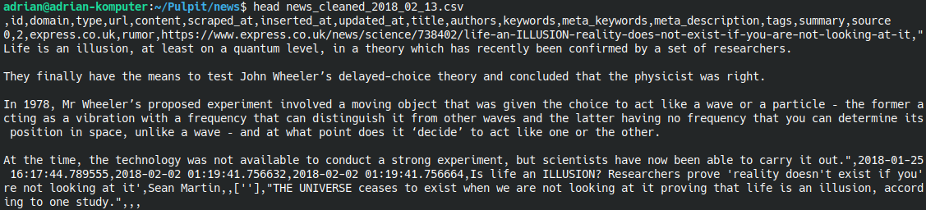
Dataset: FakeNewsCorpus
FakeNewsCorpus
1. 9 million news articles (around 30 GB of data),
2. Contains text, titles, domains, authors, timestamp,
3. 10 classes (9 misinformation types (gossip, fake news, clickbait, etc.) + Credible class),
4. Scrapping text from more than 1000 different Internet domains.

Slide 11
04
Methods Review
Notes:
During our research we encouuntered multitude of ideas of how to tackle fake news detection.

Slide 12
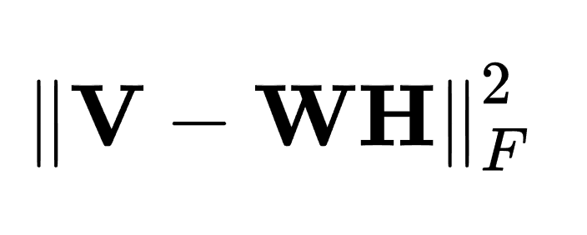
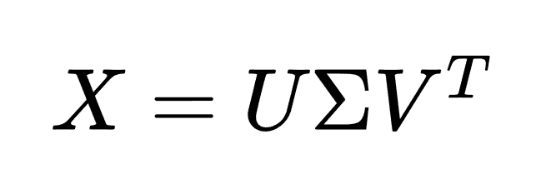
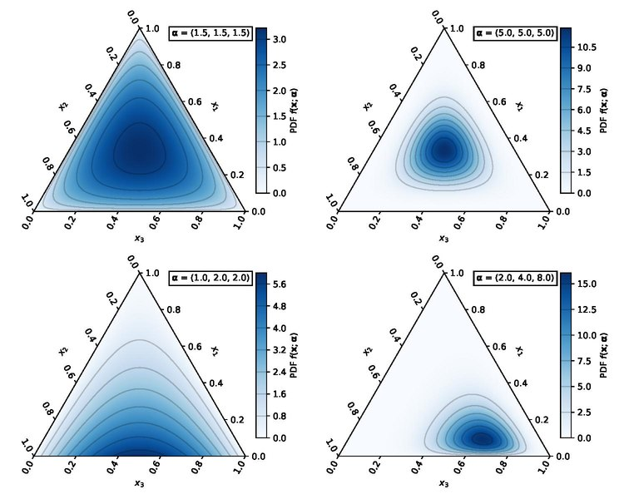
Methods review topic detection
Latent Semantic Indexing
Latent Dirichlet Allocation
Non - Negative Matrix Factorisation
https://en.wikipedia.org/wiki/Dirichlet_distribution
Notes:
For topic detection part we plan on using LSI, which transforms a term-document matrix using Singular Value Decomposition, LDA assumes that each document is a mixture of topics, and each topic is a mixture of words. LDA tries to reverse-engineer these mixtures. NMF on the other hand is as the name suggest factorisation algorithm than based on word-document matrix creates word-topic and topic-document matrices, such that all their values are positive and their product is as close as possible to original matrix with regards to Frobenius norm

Slide 13
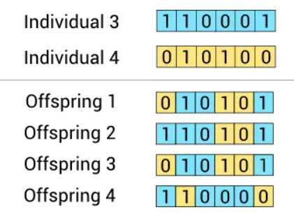
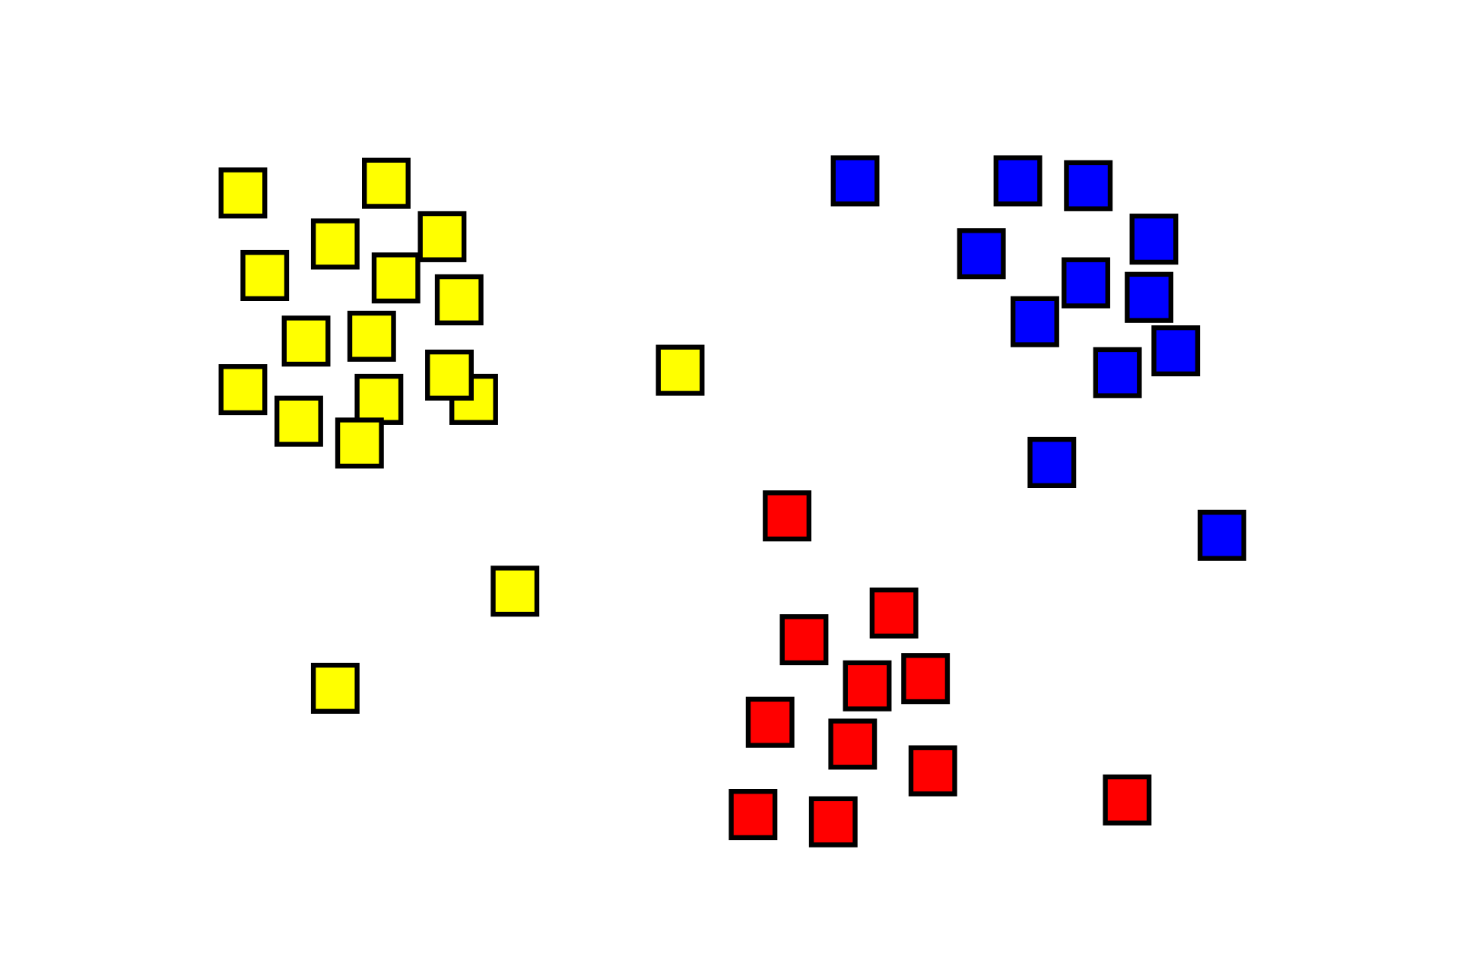
Methods review fake news detection
GeFES
Clustering
as feature selection
Models:
Bert
Passive agressive
KNN
BiDir-LSTM-CNN
SVM
https://www.neuraldesigner.com/blog/genetic_algorithms_for_feature_selection/
https://en.wikipedia.org/wiki/Cluster_analysis
Notes:
When it comes to NLP we always have to deal with a lot of features as documents can be long and wwe often encode each word separately. To counteract this we plan to use feature selection for which we found two interesting methods: Genetic and Evolutionary Feature Selection, creates feature mask that maximizes accuracy of K- nearest neighbor model, and calculates it using genetic algorithm. The other feature selection method is much simpler as it is based on clustering the predictors and selecting one predictor variable from each cluster that explains best the target variable.
For modeling purposes we encountered succesful solutions based on SVMs, K-nearest neighbors, LSTM, Passive agressive that is passive as it doesn't refit if model makes correct prediction and agresively changes when it makes the mistake. And Bert, which doesn't need introduction.

Slide 14
Methods review XAI
Intrinsic interpretability
Approximation based explaination
XAI
Post-Hoc interpretability
Feature importance
Notes:
It is a constant struggle to understand the inner workings of machine learning models, especially ones for NLP as models easiest to explain aren’t cutting-edge when it comes to fake news detection. Intrinsic interpretability(models of simple structure), Post-hoc interpretability(interpreting model after training), feature importance, local approximation based explanation(approximation of black-box model using white-box model) and attention based explainability.

Slide 15
05
Proposed solution

Slide 16
Proposed solution
We will use SOTA topic detection tools, based embeddings, noun chunks, n-grams, named entity recognition, etc.
We evaluate the clustering quality with SOTA approaches mentioned in the Literature Review.
We prepare a train-test split with regard to particular clusters (ex. 70% - 30%: training – testing).
We prepare a few (1-3) SOTA solutions for fake news detection methods.
We will train and evaluate them on a global split.
We will train and evaluate them on local clusters.
We will compare the results of global and local models in terms of performance.
We will use eXplainable AI (XAI) methods to discover the most important indicators for global and local methods.

Slide 17
Expected Contributions
We will combine SOTA methods for the topic and fake news detection into a novel approach to the early detection of rumors.
We will evaluate our local approach, and compare this to current, global solutions.
We will explore the differences between the two strategies with the usage of XAI.
If the proposed framework proves to be better in terms of performance, it will be faster due to the limitation to a particular topic.
The outcomes of our study might lead to further research in the area of local topic modeling.

Slide 18
Thank you for your attention!

